Slide 1



The BEPS action plan: French anticipation and European adjustments
Master 2 DFA – Rennes Law School
16 June 2016

Slide 2
Introduction: the BEPS Project
Context
The growth of international trade has induced multinational companies to focus on the search for the most tax-efficient legal structures.
Faced with these strategies, the weaknesses of current rules create opportunities for base erosion and profit shifting.
Impact
The total impact on States tax income is assessed between 4 to 10 % of the overall corporate tax worldwide income.
The first objective is to restore confidence in the system.
The second objective is to ensure that profits are taxed where economic activities take place and value is created.
Objectives
It means 100 to 240 billion euros per year.

Slide 3
Introduction: the BEPS Project
Action 2
Neutralise the effect
of hybrid mismatch arrangements
Action 4
Limit base erosion via interest deductions and other financial payments
Action 3
Strengthen CFC rules
Action 5
Counter harmful tax practices more effectively, taking into account transparency and substance
1-Coherence
Action 6
Prevent treaty
abuse
Action 7
Prevent the artificial avoidance of PE Status
Action 8/9/10
Assuring that TP outcomes are in line with value creation
Action 1
Address the tax challenges of the digital economy
Published 16/09/2014
Action 15
Develop a multilateral instrument
Feasability report Published 16/09/2014
2-Substance
Action 11
Establish methodologies to collect and analyse data on BEPS and the actions to address it
Action 12
Require taxpayers to disclose their aggressive tax planning arrangements
Action 13
Re-examine transfer pricing documentation
Action 14
Make dispute resolution mechanism more effective
3- Transparency

Slide 4
Introduction: BEPS envisaged solutions ?
Minimum standards
Reflect commitments to implement standards proposed in final reports.
Common approaches
Reflect the agreement on “general tax policy direction” which finally aims at becoming “Minimum standards”.
Best practices
Proposed when negotiators fail to reach a consensus.
Reinforcement of international standards
Reflects the need to fill loopholes in current international standards (e.g. OECD Model Convention).

Slide 5
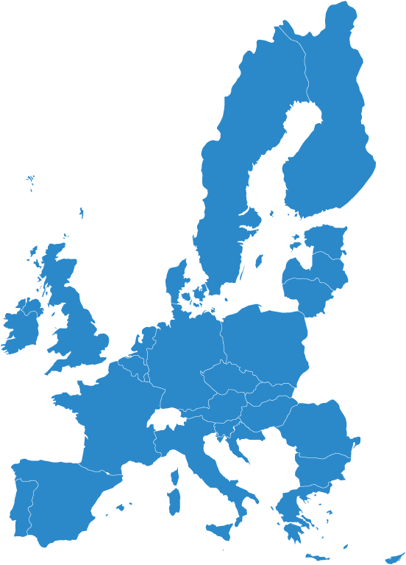
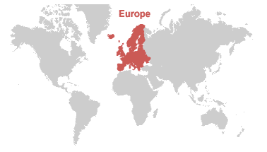
Introduction : European Union reaction
Sweden
Finland
Estonia
Latvia
Denmark
Lithuania
Ireland
United Kingdom
Netherlands
Poland
Belgium
Germany
Czech Republic
Slovakia
Austria
Hungary
France
Slovenia
Croatia
Romania
Italy
Bulgaria
Spain
Portugal
Greece
Malta
Cyprus

Slide 6
Introduction : European Union reaction
January 2016: publication of the Anti-Tax Avoidance Package:
    Revised Administrative Cooperation Directive;
    Recommendation on Tax treaties;
    Proposal of an Anti Tax Avoidance Directive (“ATAD”) with 6 legally-binding anti-abuse measures:
Interest deduction rules;
CFC rules;
Framework to tackle hybrid mismatches;
Exit tax measure;
General Anti Abuse Rule (GAAR);
Switch over clause.
Already mentioned in the BEPS project
Adjunction to the BEPS project

Slide 7
Agenda
1 - The combination of the BEPS project, French law and the
ATA Directive
  1.1 - Consistency pillar: interest deduction limitations, CFC and anti-hybrids rules
  1.2 - Substance and transparency pillars: CbCR, LOB/PPT and PE
2 - How the EU intends to go further than the OECD
  2.1 – Proposal of a General Anti abuse rule (GAAR)
  2.2 – Proposal of a Switch Over clause

Slide 8

1- The combination of the BEPS project, French law and the ATA Directive

Slide 9
  1.1 - Consistency pillar: interest deduction limitations, CFC and anti-hybrids rules
BEPS: excessive interest deduction limitation
Action 4: the best practice aims at tackling excessive interest deduction
Limitation of the amount of deductible interest through 2 ratios relying on EBITDA:
  Fixed ratio: deduction limited to a percentage (between 10 and 30%) of a company’s EBITDA;
  Group ratio: for companies that exceed the previous threshold.
Three different tax regimes applying to non-deductible interest upon option
Possible carry back and forward mechanisms
Optional de minimis threshold

Slide 10
  1.1 - Consistency pillar: interest deduction limitations, CFC and anti-hybrids rules
France: excessive interest deduction limitation
Art. 212.II of the FTC
Art. 212 bis of the FTC
Add-back of 25% of net financial expenses in excess of EUR 3.000.000.
The amount of interests received by the company from affiliated entities.
25% of the EBITDA ;
A ratio of interest to 1.5 times the equity of the company ;
Limitation deduction of interest paid to related party exceeding each of the following thresholds :

Slide 11
  1.1 - Consistency pillar: interest deduction limitations, CFC and anti-hybrids rules
ATAD Proposal: excessive interest deduction limitation
More favourable rules than Action 4
Possible carry-forward
of non-deductible borrowing costs in the fiscal year without time limitation or;
Possible carry-back of non-deductible borrowing costs in the fiscal year over 3-years period or;
Possible carry-forward of unused capacity for 5 years (excess EBITDA).
Safe harbor rule :
No limitation under EUR 3.000.000 of borrowing costs at the level of the Group,
Full deduction if the taxpayer is a standalone entity,
Full deduction if the company’s equity/assets ratio if ≥ the equivalent ratio of the Group.
Deduction limited to 30% of EBITDA

Slide 12
  1.1 - Consistency pillar: interest deduction limitations, CFC and anti-hybrids rules
Rules should at least target situations where resident taxpayers have a legal or economic interest of more than 50% in the foreign entity;
Two approaches are developped : entity and transactional approach.
BEPS: controlled foreign compagnies (CFC)
Transactional approach
Unattribuable income
PC
CFC
Only attributable incomes
Attribuable income
Entity approach
Unattribuable income
PC
CFC
Both attributable and non attributable incomes
Attribuable income

Slide 13
  1.1 - Consistency pillar: interest deduction limitations, CFC and anti-hybrids rules
France: controlled foreign companies (CFC)
Art. 209 B of the FTC:
  Company established in France, liable to income tax,
  Holding, directly or indirectly, more than 50% of a company established in a foreign country,
  Subject to a favorable tax regime within the meaning of French rules.
Entity approach

Slide 14
  1.1 - Consistency pillar: interest deduction limitations, CFC and anti-hybrids rules
ATAD Proposal: controlled foreign companies (CFC)
Definition of a CFC
Same criteria as applied in France
Option for two approaches
Entity/categorical approach
Transactional approach

Slide 15
  1.1 - Consistency pillar: interest deduction limitations, CFC and anti-hybrids rules
BEPS: neutralizing hybrid mismatches
Non Inclusion of the payment
A Co.
A Co
Deduction of interest paid with respect to a loan made by a disregarded entity
Hybrid financial instrument
Interest
B Co
Bank
B Co.
Loan
Deduction of the payment
Deduction of interest paid by a resident company

Slide 16
  1.1 - Consistency pillar: interest deduction limitations, CFC and anti-hybrids rules
BEPS: neutralizing hybrid mismatches
Two rules
The payer’s jurisdiction must deny deduction when the payment is not included in taxable income of the payee;
Defensive rule: the payee’s jurisdiction must tax the income when it has been deducted in the payer’s jurisdiction.

Slide 17
  1.1 - Consistency pillar: interest deduction limitations, CFC and anti-hybrids rules
France: neutralizing hybrid mismatches
Outgoing flow : denial of deduction of interest taxed in the payee’s jurisdiction less than a 1/4 of the tax that would have been paid in France on those interest
Incoming flow: denial of the participation exemption regime if the dividend is deducted in the payee’s jurisdiction.
No safeguard provisions.

Slide 18
  1.1 - Consistency pillar: interest deduction limitations, CFC and anti-hybrids rules
ATAD Proposal: neutralizing hybrid mismatches
Double deduction
Deduction is only granted in the Member State where the payment has its source
Deduction without inclusion
Member State of the payer shall deny the deduction of the payment

Slide 19
  1.2 – Substance and transparency pillars: CbCR, LOB/PPT and PE
BEPS: transparency, the obligation of transfer pricing documentation
The master file & the local file
Organize rules at 2 levels
Information regarding intangible assets, intra group transactions…
Failure to comply with such requirements triggers the application of penalties
The Country by Country reporting
  Minimum standard
  Ensures that tax authorities obtain a complete understanding of the way MNEs structure their transactions
  Requires follow-up and cooperation between local tax authorities
27 January 2016 : 31 Countries signed the MCAA for the automatic exchange of CBCR.

Slide 20
  1.2 – Substance and transparency pillars: CbCR, LOB/PPT and PE
France: transparency, the obligation of transfer pricing documentation
The obligation to have TP documentation is not new in France
2010
Transmission of “master file” + “local file”
2016
2016 Financial Law: As of January 1st 2016, the CbCR is implemented for French groups with a 750-million-euro turnover or more

Slide 21
  1.2 – Substance and transparency pillars: CbCR, LOB/PPT and PE
ATAD Proposal: transparency, the obligation of transfer pricing
documentation
12 April 2016 : proposition to amend the Accouting Directive 2013/34/EU to introduce public CbCR for MNEs;
25 May 2016 : adoption of a political agreement on the automatic exchange of tax-related financial information of multinational companies.
The aim is to impose on EU and non-EU multinational groups the publication of a yearly report on the profit and tax paid.

Slide 22
  1.2 – Substance and transparency pillars: CbCR, LOB/PPT and PE
BEPS: substance, LOB and PPT clauses
2 mechanisms to deny treaty benefit:
Limitation-on-benefits clause:
  Specific anti abuse rule (SAAR)
  Objective rule
Principal purposes test clause:
  General anti abuse rule (GAAR)
  Subjective rule
“minimum standard” = option for States (PPT alone, PPT + LOB or LOB + specific mechanism that deals with conduit arrangements)

Slide 23
  1.2 – Substance and transparency pillars: CbCR, LOB/PPT and PE
France: substance, LOB and PPT clauses
France inserted some anti-abuse clauses in its double tax treaties, which aim and formulation are rather equivalent to those of the OECD.
Before BEPS
After BEPS
DTT with US (1994), Japan (1995), Panama (2011): LOB clause.
DTT with Colombia dated June 2015: LOB clause.
DTT with Singapore dated January 2015: GAAR.

Slide 24
  1.2 – Substance and transparency pillars: CbCR, LOB/PPT and PE
ATAD Proposal: substance, LOB and PPT clauses
In the ATAD Proposal, no reference made to the LOB and the PPT.
However, on its recommendation on the implementation of measures against treaty abuses adopted on May 13th 2016, the Commission encourages Member States to implement a GAAR based on a PPT in their double tax treaties.

Slide 25
  1.2 – Substance and transparency pillars: CbCR, LOB/PPT and PE
BEPS: substance, the new definition of the permanent establishment
Awareness that PE are commonly used for tax purposes by the MNEs;
Circumvention of the the existing definition of PE.
Impact on the commissionaire agreement
Impact on the independent agent status
Amendment for exceptions of the permanent establishment status
Addition of an anti-fragmentation rule

Slide 26
  1.2 – Substance and transparency pillars: CbCR, LOB/PPT and PE
ATAD Proposal: substance, the new definition of the permanent
establishment
No provision is directly provided in the ATAD Proposal
Recommendation of the 28th January 2016 on the implementation of measures against treaty abuses:
Member States are encouraged to implement the new provisions of Article 5 in their tax treaties, to address artificial avoidance of PE.

Slide 27
2 - How the EU intends to go further than the OECD

Slide 28
  2.1 – Proposal for a General Anti Abuse Rule (GAAR)
The scope of the GAAR
Ignores arrangements or series of arrangements where the main or one of the main purposes are to obtain a tax advantage that defeats the object or purpose of the applicable tax law and where the arrangements are not regarded as genuine.
Tackles abusive schemes not covered by a specific domestic rule.
Covers relations both between EU Member States and relationships with non EU countries (and also domestic relationships).
No precision about the tax concerned.

Slide 29
  2.1 – Proposal for a General Anti Abuse Rule (GAAR)
The content of the GAAR
Proportionate method (different from the “all or nothing” method).
Only the part of the scheme which does not have an economic substance will be ignored for the purpose of calculating the tax liability.

Slide 30
  2.2 – Proposal for a Switch Over Clause
The findings
2 methods to eliminate double taxation:
  Exemption
  Tax credit
Parent-subsidiary Directive: exemption of withholding tax on dividends or tax credit

Slide 31
  2.2 – Proposal for a Switch Over Clause
The content of the provision
Objective: taxation of income received in the EU if not sufficiently taxed in the State of source;
Scope: dividends received from an entity in a third country and capital gains from the disposal of shares held in an entity in a third country;
Threshold: statutory tax rate of the State of source ≤ 40% of the statutory tax rate in the taxpayer Member State;
Imputation: EU entity receiving the income will be granted with a tax credit corresponding to the tax paid in the third country.

Slide 32
  2.2 – Proposal for a Switch Over Clause
The issues
Lack of details on the calculation of the tax credit;
Losses incurred by an entity deriving from disposals of shares are not taken into account;
Reference to the statutory corporate tax rate, specific incentive regimes are not considered;
No safe harbour rule;
The “switch over clause” does not apply where a treaty for the avoidance of double taxation is in place.

Slide 33
Conclusion

Slide 34
Conclusion
Novelty
BEPS : a massive
and concerted effort
against cross boarder
tax planning
Impact
Necessity

Slide 35
Questions?

Slide 36

Thank you for your attention and your warm welcome!
Université Rennes 1
Master II DFA
adeefr.asso.univ-rennes1.fr
9 rue Jean Macé
35 000 Rennes

