Slide 1



VAT
Rennes Law School

Slide 2

Introduction
Features:
  A general tax based on consumption,
  An indirect tax,
  A real and proportional tax.
Levied at each stage in the chain of production and distribution and paid, by the seller of the goods, to the Revenue authorities;
Harmonized rules in the 28 members States thanks to the EU Directive.

Slide 3
Summary
Who is a taxable person for VAT purposes?
What type of operation is subject to VAT?
Where does the taxation take place?
Is there an exemption?
Who is liable for VAT?
How to determine the VAT?

Slide 4
Who is a taxable person for VAT purposes ?
Scope of the VAT:
  any supply of goods or services;
  realized for consideration;
  by a taxable person “acting as such”.
Taxable person:
A taxable person is whoever carries out, in an usual way and on its behalf, an economic activity.

Slide 5

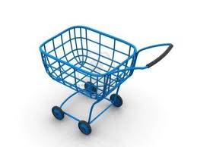

Who is a taxable person for VAT purposes ?
Illustration:
Walmart sells bread in its stores, to the customers.
VAT treatment:
    Sales of bread = (supplies of goods)
    For consideration
    Walmart is “acting as such”:
      It sells bread in an usual way and on its behalf,
      It is its economic activity.

Slide 6

Who is a taxable person for VAT purposes ?
Illustration:
Walmart offers dry cleaning services to its customers.
VAT treatment:
    Dry cleaning = supplies of services
    For consideration
    Walmart is “acting as such”:
      It cleans clothes in an usual way and on its behalf,
      It is its economic activity.

Slide 7

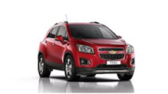
Who is a taxable person for VAT purposes ?
Illustration:
Mr. DUPONT, a teacher, sells his car to his neighbor
VAT treatment:
    Sale of the car = supply of good
    For consideration
    But Mr. Dupont is not “acting as such”:
      He doesn’t sell the car in an usual way,
      It is not its economic activity (patrimonial operation).

Slide 8
What type of transaction is supplied ?
Type of transactions considered for VAT purposes:
    Supplies of goods or services;
    Intra-Community acquisitions of goods;
    Imports.

Slide 9
What type of transaction is supplied ?
Supplies of goods or services:
  A supply of goods shall mean the transfer of the right to dispose of tangible property as an owner (notion of economic ownership),
  A supply of services shall cover every supply which is not a supply of goods (services, assignment of intangible assets or of the right to use such assets, etc.),
Intra-Community acquisitions of goods or services:
  A acquisition, by an operator located in a Member State, of any good, from an operator located in another Member State.
Imports:
  A acquisition, by an operator located in a Member State, of any good, from an operator located in another Member State.

Slide 10
Where does the taxation take place ?
Place of taxable transactions:
  Principle:
  Supply of goods
  Supply of services
  Exceptions:
  Real estate, restoration, transport, electronic services, etc.
With transport: place of transport departure
Without transport: place of delivery of goods
Business to business: place of the recipient
Business to customer: place of the supplier
Imports and
intra-Community acquisitions of goods
Place of arrival of the goods

Slide 11


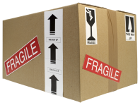


Where does the taxation take place ?
Supplies of goods or services:
Taxable in France

Slide 12
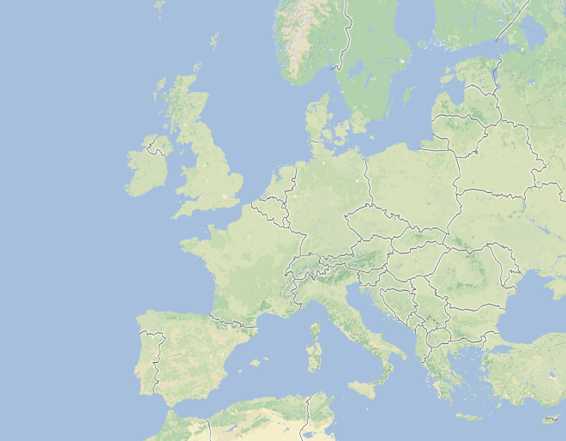


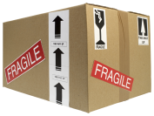
Where does the taxation take place ?
Summary
Intra-Community transaction (example):
In the UK for the supply of goods:
without transport
with transport but exempt
If B2C: In the UK
Supply of services
Supply of goods
In France, place of arrival of the transport, for the acquisition of goods
If B2B: In Spain

Slide 13
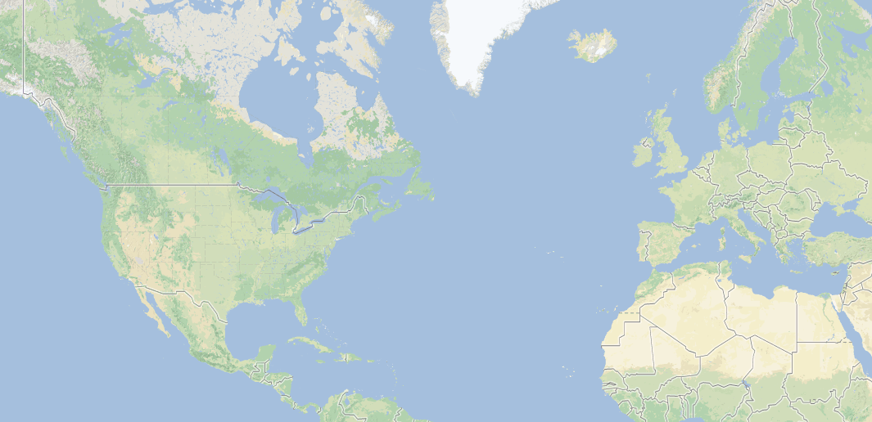


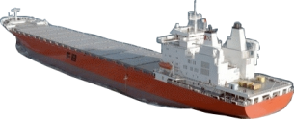
Where does the taxation take place ?
Imports (example):
Then taxed in UK
Transport to UK by truck
Unload from boat in Spain

Slide 14
Is there an exemption?
Five main categories of exemption:
  Exemptions for certain activities in the public interest;
  Tuition given privately by teachers and covering school or university education;
  Exemptions for nonprofit organizations;
  Exemptions for other activities (insurance for instance);
  Exemptions for intra-Community supplies of goods.

Slide 15
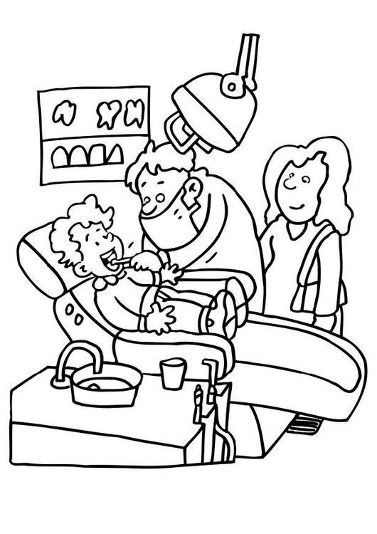

Is there an exemption?
Exemptions for certain activities in the public interest
  Hospital and medical care, dental activities, etc.;
  Supply of staff by religious or philosophical institutions;
  Bodies governed by public law and bodies which do not aim to
  make a profit.
VAT FREE PRICES

Slide 16
Is there an exemption?
Exemptions for educational activities:
  School teaching, from elementary to University,
  It also covers tuitions fees paid by student,
  But VAT applies to certain activities such as research for private entities
  carried out in competitive conditions,
  And, while a University Professor is exempt from VAT when he charges
  tuition, he is liable for VAT when he gives law advice, for example,
  against remuneration. In that case, he is a taxable person acting as such
  and his fees are subject to VAT.

Slide 17

Is there an exemption?
Exemptions for nonprofit organizations (NPO):
  NPO : entities which do not distribute their profit to the partners;
  Exemption for goods or services supplied during few events per year;
  Exemption for goods and services supplied to:
    Its members (“closed organizations”),
    Any customers (“opened organizations” if there is no competitive activity).
VAT FREE PRICES
NON PROFIT ORGANIZATION

Slide 18
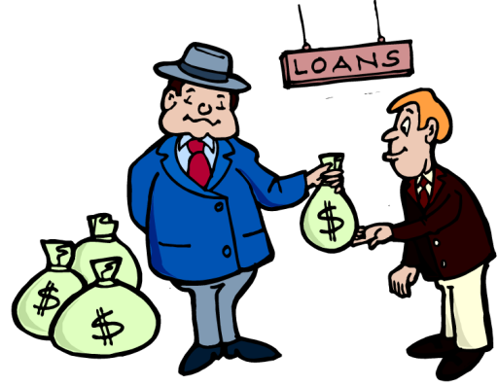
Is there an exemption?
Exemptions for other activities:
  Insurance and reinsurance transactions;
  The granting and the negotiation of credit and the management of
  credit by the granting person;
  Betting, lotteries and other forms of gambling…
VAT FREE PRICES

Slide 19
Is there an exemption?
Summary
Exemptions for intra-EU supplies of goods:
Exemption in the place of dispatch
Supply of goods
Intra-Communty acquisition of goods is taxed in the place of the recipient

Slide 20
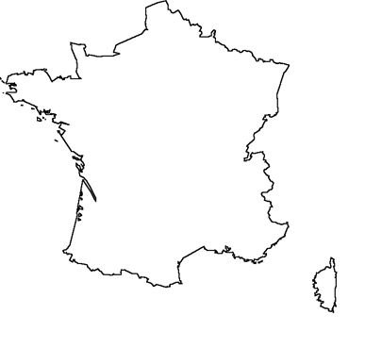


Who is liable for VAT?
Principle in a domestic transaction:
  The person liable for VAT on the supply of goods or services is the taxable person who performs the taxable transaction.
Paiement of the €0.2 VAT to the tax authorities
Price + VAT
€1 + €0.2 of VAT

Slide 21
Who is liable for VAT?
Exceptions:
  The domestic reverse charge mechanism could be applied;
  It applies when a supply of goods or services is performed by a supplier who is not established in France to a customer or recipient who is registered for VAT purposes in France;
  It means the customer or recipient will pay the due VAT instead of the supplier. In practice, the customer will self-assess the VAT on the purchase. This has the benefit of having no cash flow impact since you self-assess and deduct immediately.

Slide 22
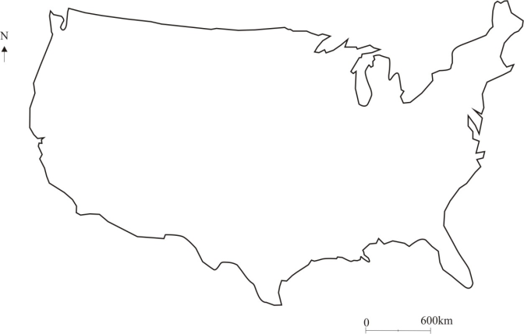



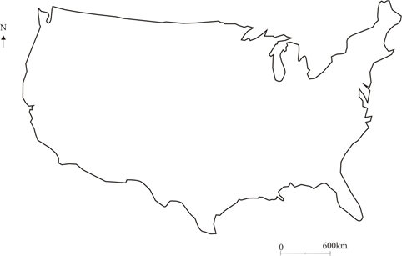


Who is liable for VAT?
Exceptions (examples):
The VAT is paid by the recipient
Supply of services
The VAT is paid by the purchaser
Supply of goods

Slide 23
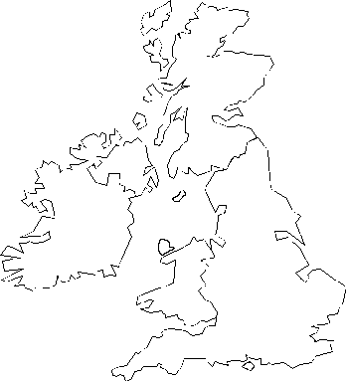


Who is liable for VAT?
Exceptions:
  The “Carousel fraud” also known as the Missing Trader Intra-Community Fraud (MTIC Fraud). In such a scheme, fraudsters import goods VAT-free from other countries, then sell the goods to domestic buyers, charging them VAT. The sellers then disappear without remitting the tax to the tax authorities.
Paiement of VAT to tax authorities
Paiement of VAT to A
Deduction of VAT
A
C
B
Sale VAT free
Sale with VAT

Slide 24
Who is liable for VAT?
  The French tax code provides three means in order to fight the carousel fraud:
    Challenge of the exemption of intra-EU supplies made by a taxable person if the supplier knew or should have known that the recipient does not have a real activity;
    Challenge of the right to deduct VAT for the purchaser if the taxable person who receives the goods or services knew or should have known there was a fraud;
    The VAT liability can be extended to the person who receives the goods or services if it knew or should have known there was a fraud. This person is jointly and severally liable to pay the VAT with the person originally liable for VAT on this transaction.

Slide 25
Who is liable for VAT?
  The French tax code provides three means in order to fight the carousel fraud:
Paiement of VAT to tax authorities
Paiement of VAT to A
Deduction of VAT
A
C
B
Sale VAT free
Sale with VAT
C will be jointly and severally liable to pay VAT

Slide 26
How to determine the VAT?
Principle of neutrality:
  VAT is a neutral tax, based on a principle of collection and subsequent deduction.
The input VAT:
  VAT incurred by the supplier,
  For its own acquisitions made in the framework of its economic activity,
  Which is invoiced by its own suppliers.
The output VAT:
  VAT invoiced to the customers by the supplier.

Slide 27
How to determine the VAT?
Output VAT:
  What is the taxable basis?
    The taxable basis is the consideration received by the supplier/provider from the purchaser;
    Subsidies directly linked to the price and paid by a third party are included in the taxable basis;
    Some elements are excluded from the taxable basis (price reductions in all their form for example).
  What amount of VAT is due?
    Due VAT = basis x rate
    Rates applicable as from 1/1/14:
      Regular rate……………………………………….20%
      Reduced rate (bare necessities)…………………...5%
      Intermediary rate (selected operations)…………...10%
      Ultra-reduced rate………………………………....2.10%

Slide 28
How to determine the VAT?
Input VAT:
  In so far as the goods and services are used for the purposes of the taxed transactions of a taxable person, the taxable person shall be entitled, to deduct input VAT from the output VAT.
Three conditions to benefit from the right to deduct VAT:
  Realization of taxable operations or equivalent;
  Strictly professional expenses;
  Expenses allocated to taxable operations or equivalent.

Slide 29

How to determine the VAT?
Illustration:
  Three conditions to benefit from the right to deduct VAT:
  Realization of taxable operations or equivalent = Yes
  Strictly professional expenses = Yes
  Expenses allocated to taxable operations or equivalent = Yes
Complete right to deduct the input VAT
€300 - €200 = €100 of VAT to be paid to the tax authorities
Input VAT:
€1000 x 20% = €200
Output VAT:
€1500 x 20% = €300

Slide 30
How to determine the VAT?
On principle, the input VAT which is totally and directly linked to a taxable activity is deductible.
In some cases, it’s impossible to determine precisely the VAT which is totally and directly linked to a taxable activity.
So a key of allocation has to be determined, on the basis of the use made of the goods and services for taxable operations.

Slide 31


How to determine the VAT?
Illustration:
  Three conditions to benefit from the right to deduct VAT:
  Realization of taxable operations or equivalent = Yes
  Strictly professional expenses = Yes
  Expenses allocated to taxable operations or equivalent = Yes up to 50%
Right to deduct the input VAT up to 50%
€100 of VAT to be paid to the tax authorities
50%
Input VAT:
€1000 x 20%= €200
50%

Slide 32
How to determine the VAT?
Adjustment of deductions:
There is a period during which the right to deduct VAT has to be monitored according to the allocation key - this period is called period of regularization.
If the allocation is modified during the period of regularization, the initial deduction shall be adjusted where it is higher or lower than the one to which the taxable person was entitled.

Slide 33

Annual adjustment of deductions:
Proportional deduction = 0.5
Deduction of 50% of the input VAT
= 0.5 x initial VAT (€200)
= €100
Purchase in 2011
Allocation for 50%
to taxable operations
Proportional deduction = 0.62
Additional deduction
= 0.12 x (initial VAT / 5)
= €4.8
Allocation for 62%
to taxable operations
2012
Proportional deduction = 0.20
Putting back
= 0.3 x (initial VAT / 5)
= €12
Allocation for 20%
to taxable operations
2013

Slide 34
How to determine the VAT?
When is the VAT declared and paid?
  Monthly, quarterly or annual returns depending on turnover.
  The return has to be sent to the tax authorities during the month after the due date.
  Balance payment (output VAT – input VAT) at the time of submission of the return.

Slide 35

How to determine the VAT?
Some Questions ?

Slide 36
Thank you for your attention, your invitation and your warm welcome

Slide 37
Université Rennes 1
Master II DFA
adeefr.asso.univ-rennes1.fr
9 rue Jean Macé
35 000 Rennes

